Slide 1

GROUP MEMBERS (Student ID):
Muhammad Awais Shaikh (20042)
Yumna Baig (20166)

Slide 2

Course:
DATA STRUCTURE AND ALGORITHM
Project:
Car Registry System
Subtitle:
Managing Car and Operations

Slide 3
INTRODUCTION
Brief explanation of the project's purpose
Importance of managing car information efficiently

Slide 4
Features Overview
Highlight key functionalities:
Adding a new car
Displaying cars older than a specific year (sorted)
Searching for a car by brand (binary search)
Adding/removing cars to/from a stack
Displaying cars in the stack
Exit option

Slide 5
Code Structure Overview
Briefly explain the code structure:
Main program structure
1
Car class properties
2
3
Methods for different functionalities
4
Arrays used for car storage and stack
implementation

Slide 6
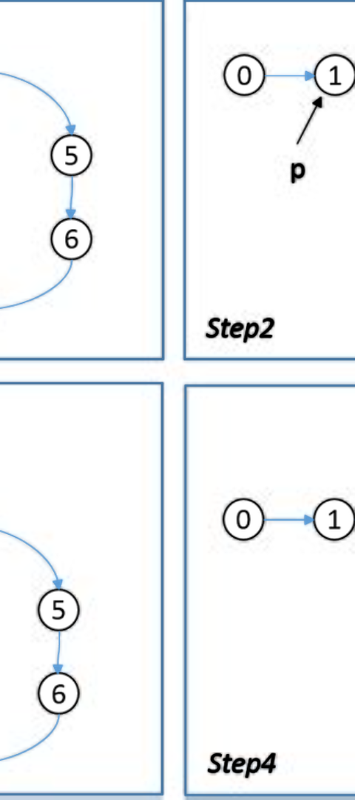
Comparer Classes
Explanation of comparer classes:
1
CarComparer for sorting
by model year
2
CarBrandComparer for sorting by brand

Slide 7
Conclusion
Summary of benefits and importance of such a system
Future improvements or enhancements

